Slide 1

Data Structures
Unit-5
Dept. of CSE,
RGUKT IIIT Srikakulam

Slide 2
Binary Search Trees(BST)

Slide 3
BST:-
To Overcome The Time Complexity Of Searching in Binary Trees, We go for BST.
In A Binary tree in which for each node, value of all the nodes in left sub tree is lesser or equal and value of all the nodes in right sub tree is greater.
If we apply In order on BST we get sorted order.
Time Complexity Of Searching in BST is
1) Average→ O(log n)
2) Worst → O(n)
8
5
11
2
6
10
12
4
7
9
14
13

Slide 4
Example and Counter-Example
8
5
5
11
4
8
2
7
6
10
18
1
7
11
4
15
20
3
NOT A
BINARY SEARCH TREE
BINARY SEARCH TREE
21

Slide 5
BST:-
We can perform different type of operations on BST like find, insertion , deletion etc.,
Iterative Find:
Node *
find(Comparable key, Node * t)
{
while (t != NULL && t->key != key)
{
if (key < t->key)
t = t->left;
else
t = t->right;
}
return t;
}
10
5
15
2
9
20
7
17

Slide 6
Insert
->we can do recursive find also
void
insert(Comparable x, Node * t)
{
if ( t == NULL ) {
t = new Node(x);
} else if (x < t->key) {
insert( x, t->left );
} else if (x > t->key) {
insert( x, t->right );
} else {
// duplicate
// handling is app-dependent
}
Concept:
Proceed down tree as in Find
If new key not found, then insert a new node at last spot traversed

Slide 7
Deletion - Leaf Case You can directly delete if it is leaf node
Delete(17)
10
5
15
2
9
20
7
17
30

Slide 8
Deletion - One Child Case
Delete(15)
10
Procedure:
Append the child of deleted node to parent node and then delete
5
15
2
9
20
7
30

Slide 9
Deletion - Two Child Case
10
Procedure:
Take left sub tree maximum or right sub tree minimum and replace with the deleted element
5
20
2
9
30
Delete(5)
7

Slide 10
Generally searching of a node in BST is O(log n) where n is the total number of nodes.
But in Worst case it will get O(n) time complexity to search for a node i.e., when the tree is completely left skewed or right skewed BST.
So, to overcome this drawback, we move for Balanced Binary Search Trees:
1) AVL Trees
2) Red Black Trees
3) Splay Trees
where you will get a time complexity for searching is O(log n)

Slide 11
AVL Trees
An AVL TREE is a Binary Search Tree with balance condition in which the sub-trees of each node can differ by at most 1 in their height.
The technique of balancing the height of binary trees was developed by Adelson, Velskii, and Landi and hence given the short form as AVL tree or Balanced Binary search Tree.

Slide 12
Why we are moving to AVL TREES?
The disadvantage of a binary search tree is that its height can be as large as N-1.
This means that the time needed to perform insertion, deletion and many other operations can be O(N) in the worst case.
So we need a tree with small height.
A binary search tree with N node has height at least O(N) at worst case.
Thus, our goal is to keep the height of a binary search tree in the worst case also O(log N).
Such trees are called balanced binary search trees. Examples are AVL tree, red-black tree, splay trees , B- Trees etc.,

Slide 13
AVL Tree:
1. Sub-trees of each node can differ by at most 1 in their height.
2. Every sub-trees should be an AVL tree.
3. In AVL Tree, Every node can have balance factor either -1, 0 or +1 and remaining balance factor for a node can be called as invalid AVL Tree.
4) The height of an AVL tree storing n keys is O(log N).
5) Balance factor of a node.
BF=height(left subtree) - height(right subtree).
6) calculate balance factor calculated at every node.
7) AVL Tree stores balance factor in each node.

Slide 14
INSERTION:
Insertion is similar to regular binary search tree, after inserting check the balance factor of each node.
If any node having balance factor other than -1, 0 or +1, we need to balance the tree.
To make balance the tree, we need to apply rotations there fore it guarantees O(log n) time complexity.
Different types of rotations are:
Single rotation:
1) LL 2) RR
Double rotation:
1) LR 2) RL

Slide 15
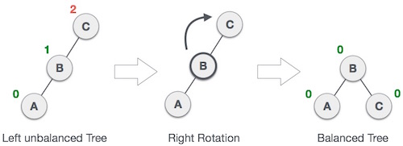
DOUBLE ROTATION
1.LL NOTATION.
When the node is inserted at the left side of left sub tree which has balanced factor +2,that condition is called LL notation.
Rotate the parent in clockwise direction.

Slide 16
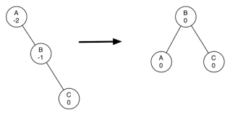
2.RR NOTATION
When the node is inserted at right side of right sub tree which has no right sub tree, that condition is called RR notation.
Rotate the parent in anti-clockwise direction.

Slide 17
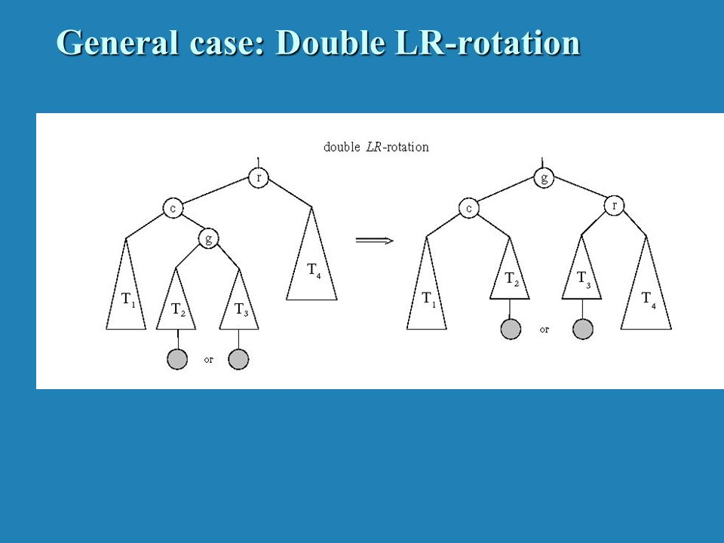
DOUBLE ROTATION
LR NOTATION
When the node is insterted at right side of left sub tree which has no right sub tree,that condition is called LR notation.
Rotate the parent in ANTI-CLOCKWISE and then CLOCKWISE direction in LR notation.

Slide 18
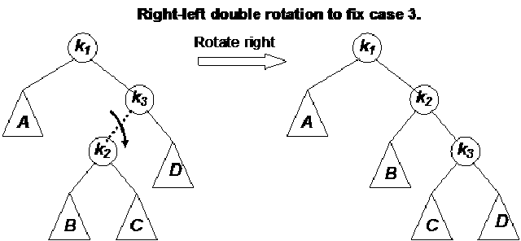
2.RL NOTATION
When the node is inserted at left side of right sub tree of a node which has no left sub tree, that condiiton is called RL notation.
Rotate the parent in CLOCKWISE and then ANTI-CLOCKWISE directionin LR notation.

Slide 19
AVL Tree Example:
Insert 14, 17, 11, 7, 53, 4, 13 into an empty AVL tree
14
11
17
7
53
4
After inserting node 4, AVL Tree is imbalanced i.e., for node 11, the balance factor is +2.
The Balance factor +2 means, tree is unbalanced, so we need to find what kind of notation applied to the tree.
Here we will apply LL notation based on the above slides

Slide 20
Insert 14, 17, 11, 7, 53, 4, 13 into an empty AVL tree
14
7
17
4
11
53
13

Slide 21
AVL Tree Example:
Now insert 12
14
7
17
4
11
53
13
12

Slide 22
AVL Tree Example:
Now insert 12
14
7
17
4
11
53
12
13

Slide 23
AVL Tree Example:
Now the AVL tree is balanced.
14
7
17
4
12
53
11
13

Slide 24
AVL Tree Example:
Now insert 8
14
7
17
4
12
53
11
13
8

Slide 25
AVL Tree Example:
Now insert 8
14
7
17
4
11
53
8
12
13

Slide 26
AVL Tree Example:
Now the AVL tree is balanced.
14
11
17
7
12
53
4
8
13

Slide 27
DELETION
While performing Deletion, we will follow same cases of Binary search tree.
Deletion of a node can be either a
1) zero children node
2) single children node
3)two children node.
After performing deletion, need to check balance factor of each node, if tree is Violating the AVL Tree properties then you need to rebalance the entire tree.

Slide 28
Balancing the AVL Tree after deleting a node:
To balance the AVL tree after deleting, we have to do some rotations.
They are
1.R0 ROTATION
2.R1 ROTATION
3.R-1 ROTATION
4. L0 ROTATION
5. L1 ROTATION
6. L-1 ROTATION

Slide 29
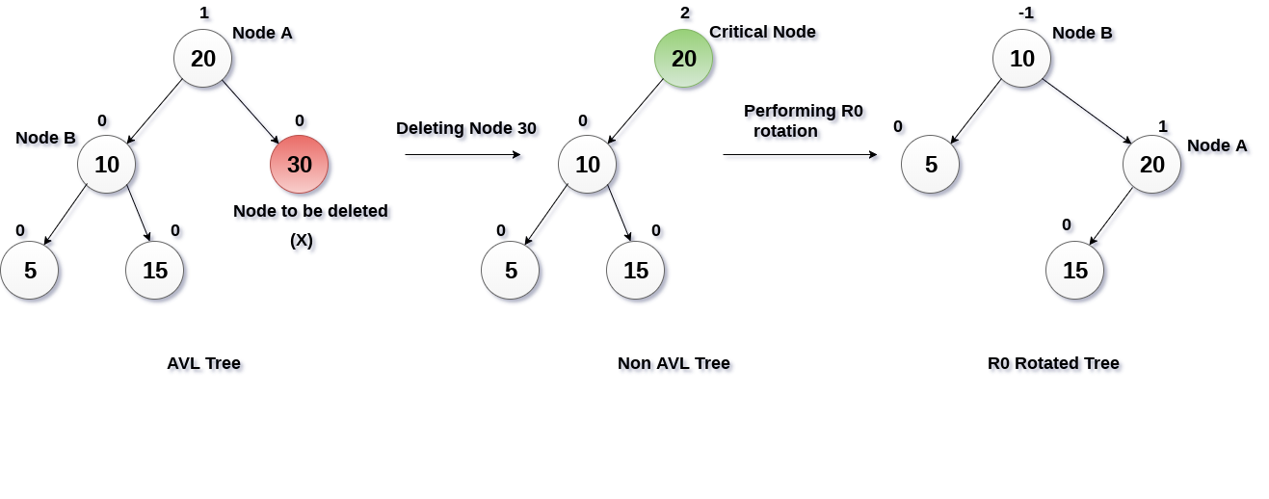
Deletion at right side:-
1.R0 ROTATION:-
If the deleted node is at the right side of a tree and the balance factor of the root node is +2 and the left first child balance factor is 0,we call it as R1 notation.
Rotate the left child or the parent in clockwise direction.

Slide 30
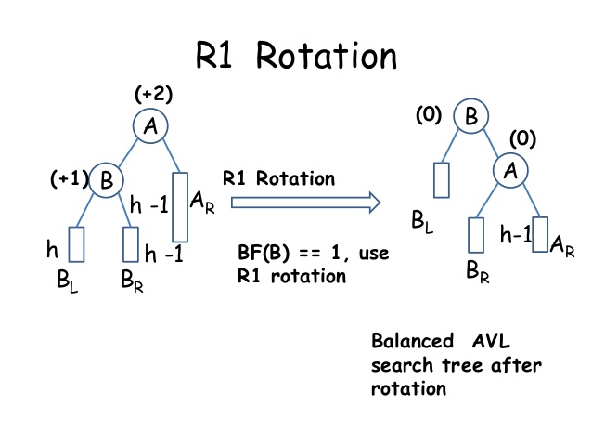
2.R1 ROTATION:-
If the deleted node is at the right side of a tree and the balance factor of the root node is +2 and the left first child balance factor is 1,we call it as R1 notation.
Rotate the left child of the parent in clockwise direction.

Slide 31
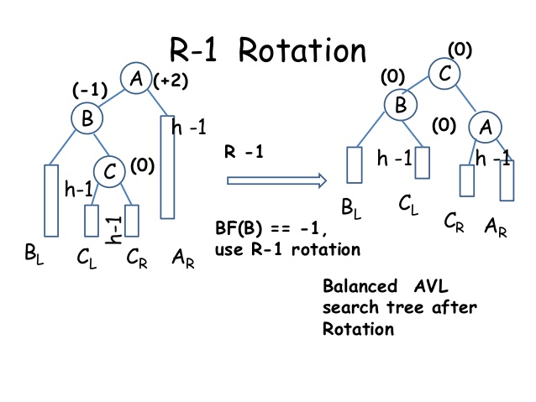
3.R-1 ROTATION
If the deleted node is at the right side of a tree and the balance factor of the root node is +2 and the left first child balance factor is -1,we call it as R1 notation.
Rotate the left child of the parent in anti-clockwise direction and then in clockwise direction.

Slide 32
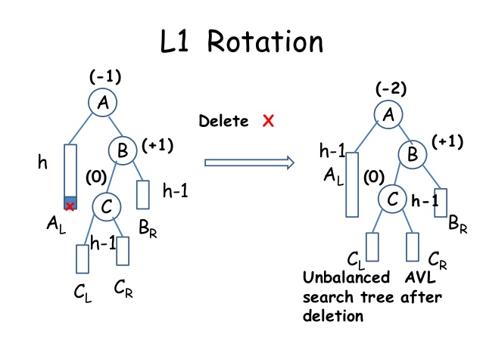
2.Deletion at left side
1.L1 ROTATION
If the deleted node is at the left side of a tree and the balance factor of the root node is -2 and the right first child balance factor is +1,we call it as R1 notation.
Rotate the right first child of the parent in clockwise and then anti-clockwise to balance here.

Slide 33
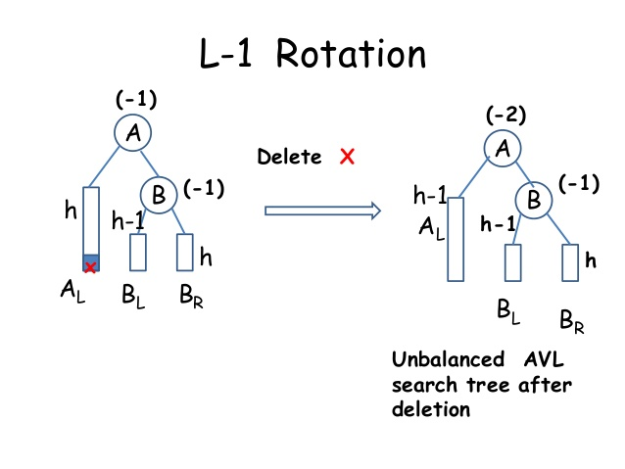
2.L-1 ROTATION:-
If the deleted node is at the left side of a tree and the balance factor of the root node is -2 and the right first child balance factor is -1,we call it as L-1 notation.
Rotate the right first child of parent in anti-clockwise direction to balance here.

Slide 34
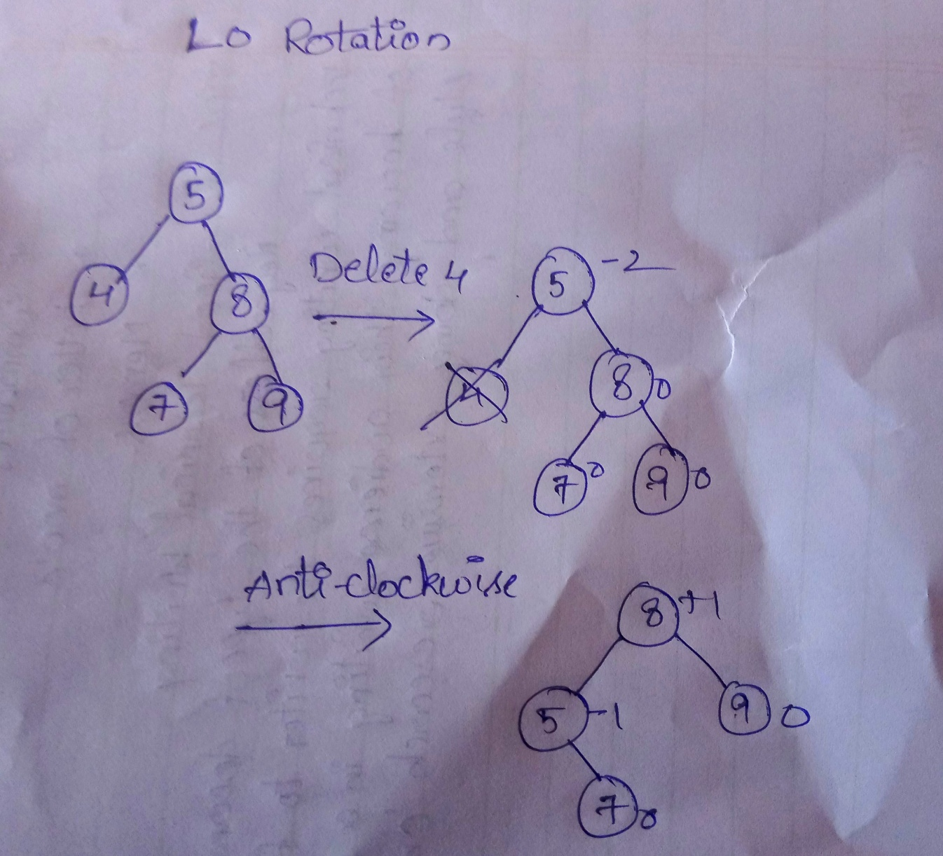
3.L0 ROTATION:-
If the deleted node is at the left side of a tree and the balance factor of the root node is -2 and the right first child balance factor is 0,we call it as L0 notation.
Rotate the right first child of parent in anti-clockwise direction to balance here.

Slide 35
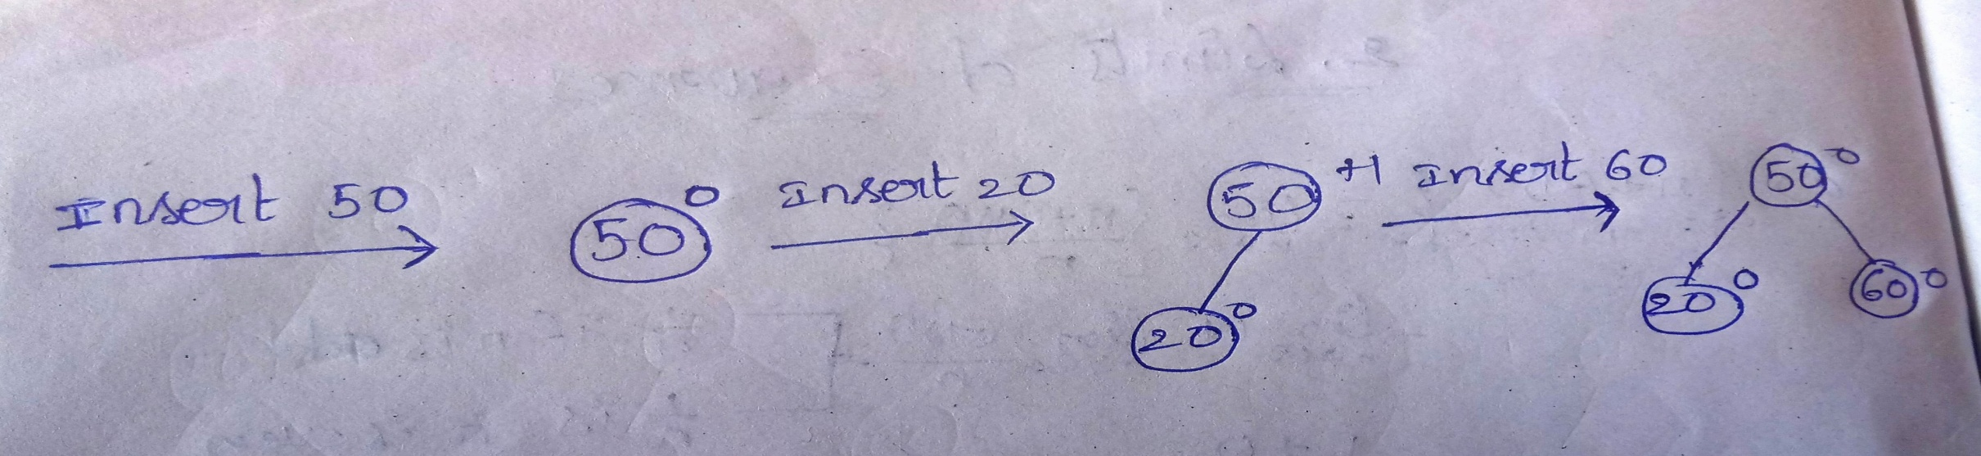
Eg:-INSERT 50,20,60,10,8,15,32,46,11,42 AND THEN DELETE THE NODES 46,15,50.

Slide 36
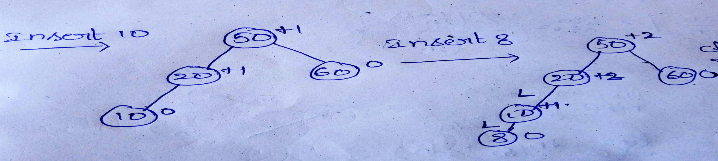
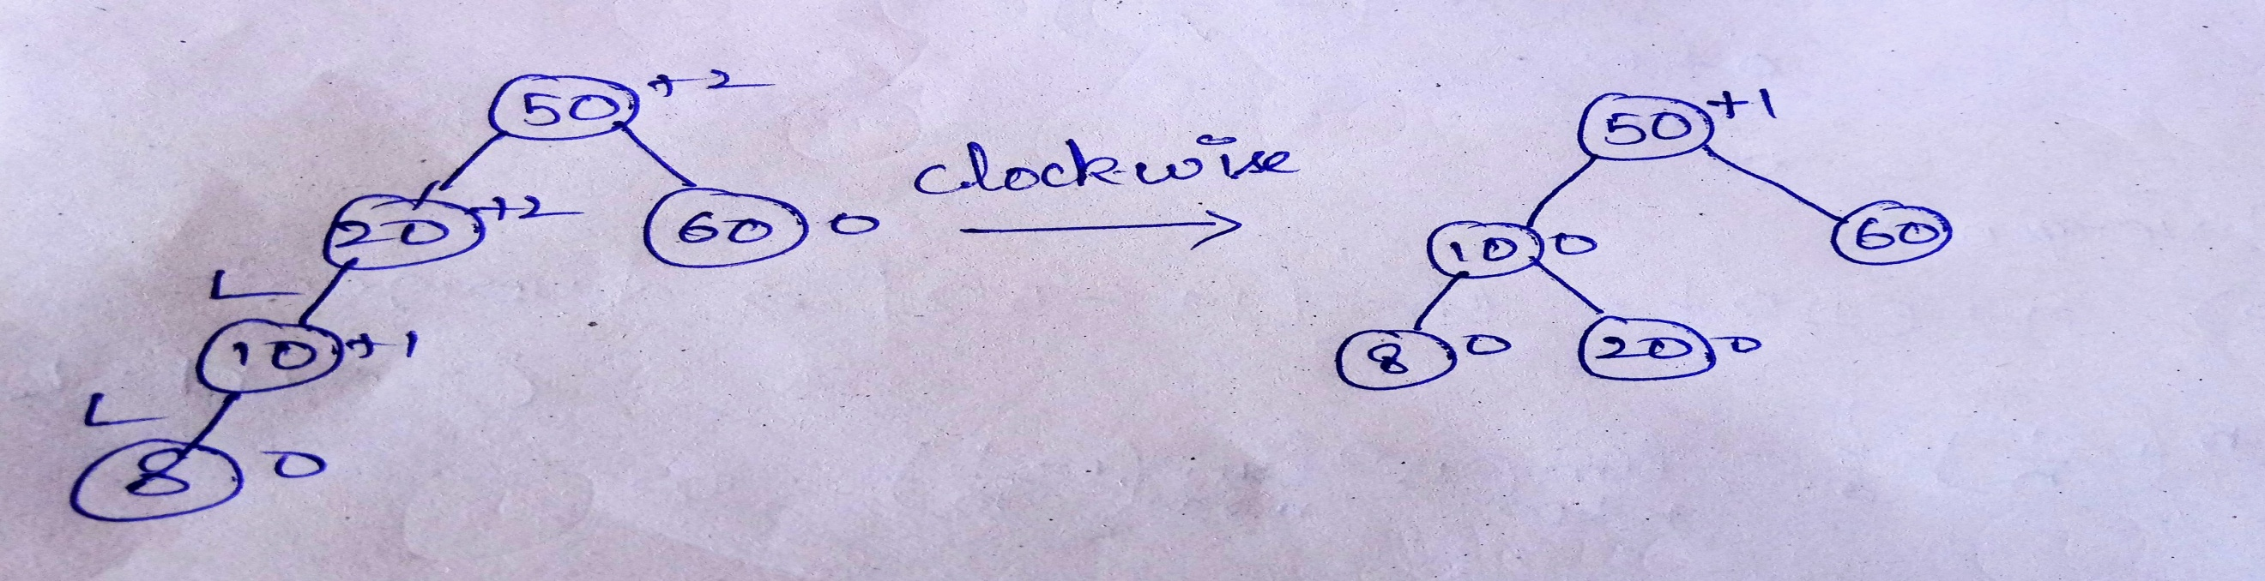

Slide 37
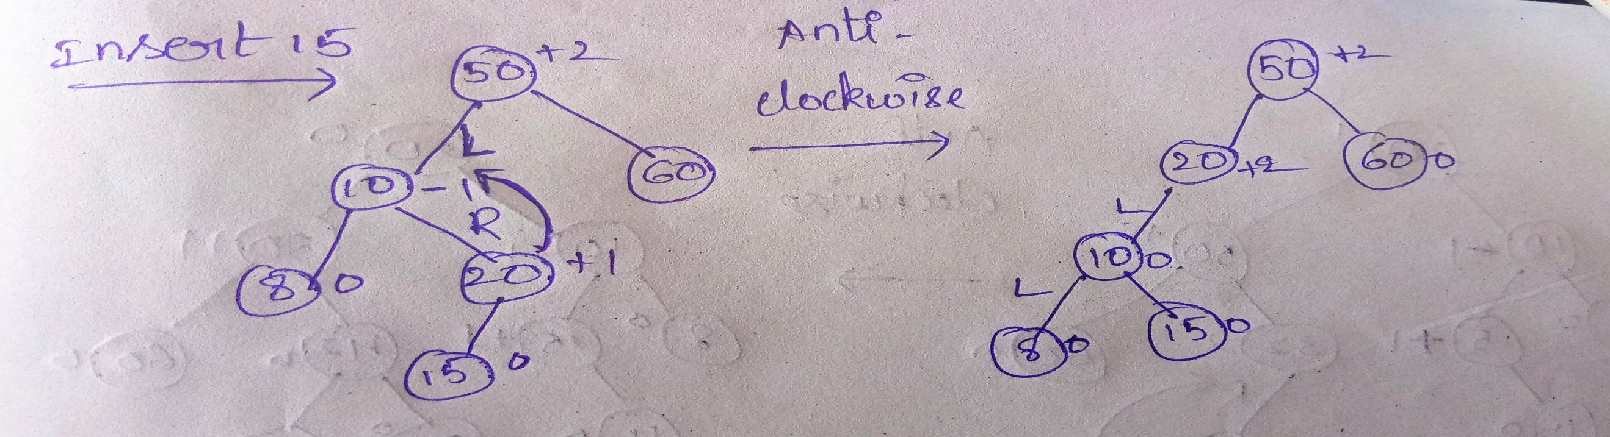
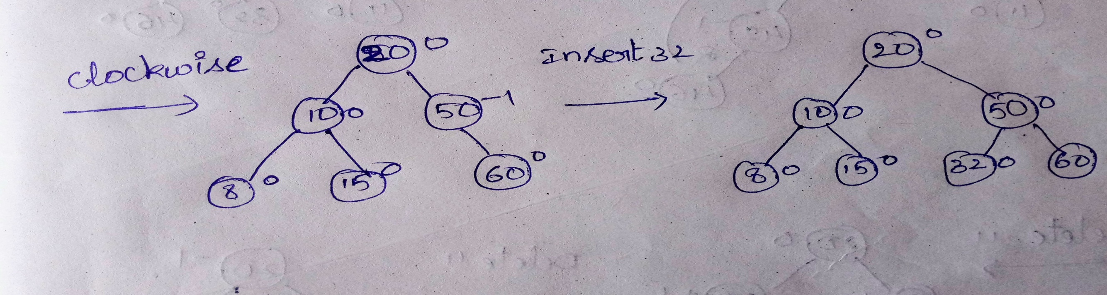

Slide 38
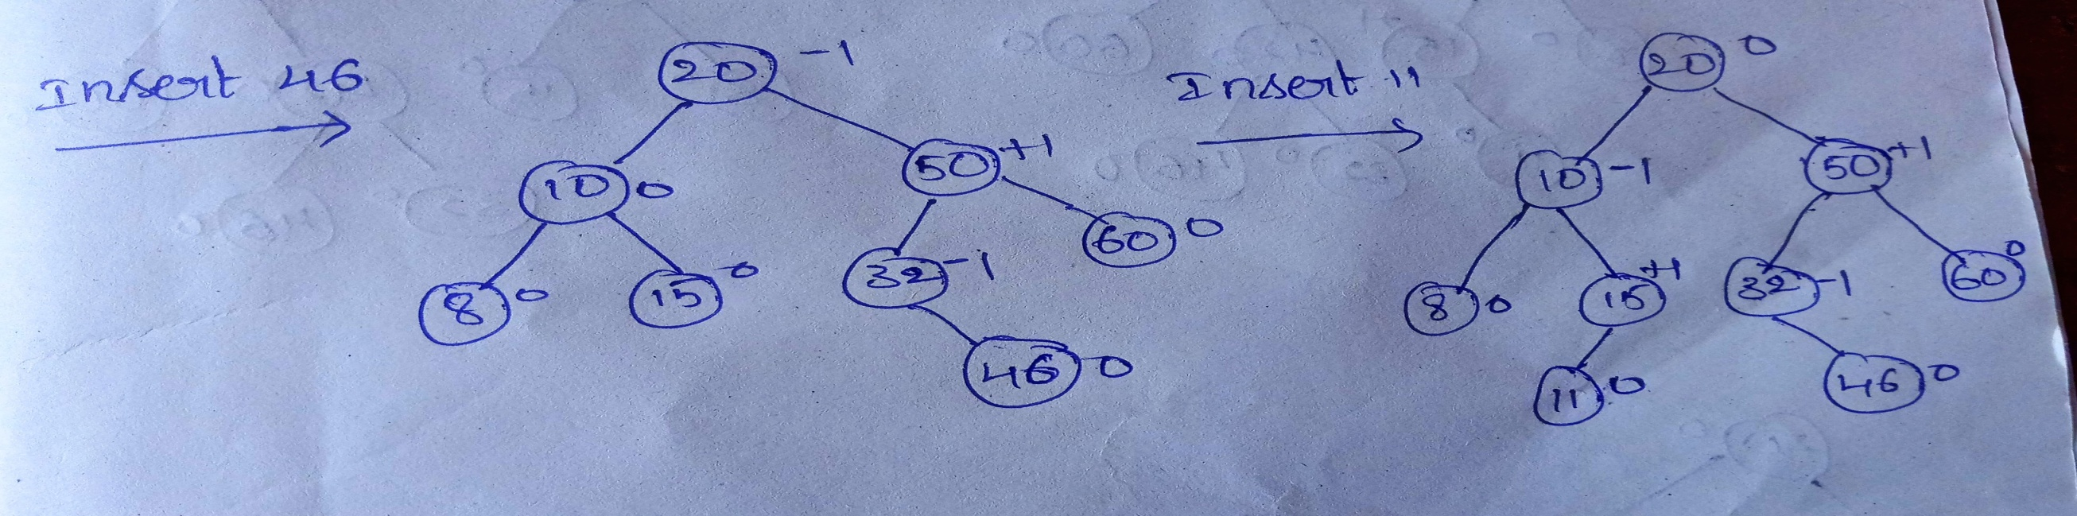
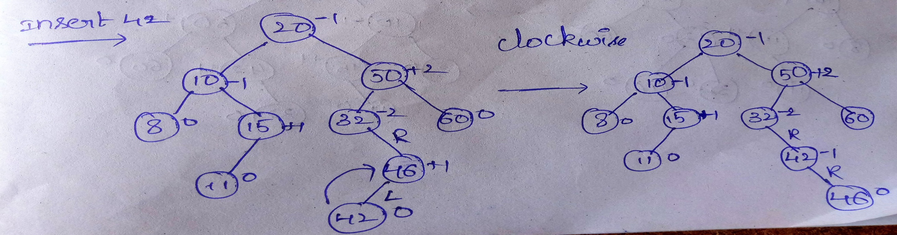

Slide 39
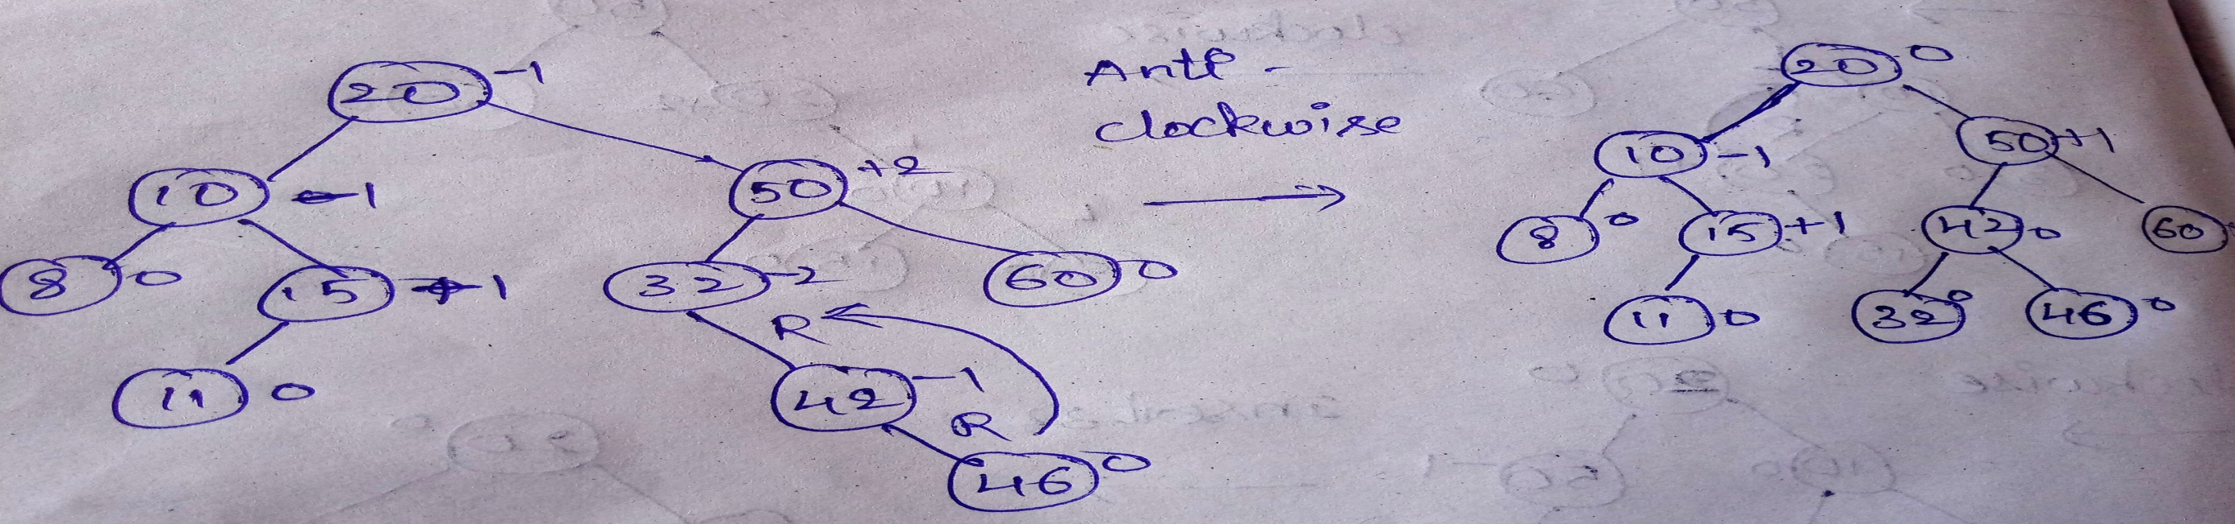
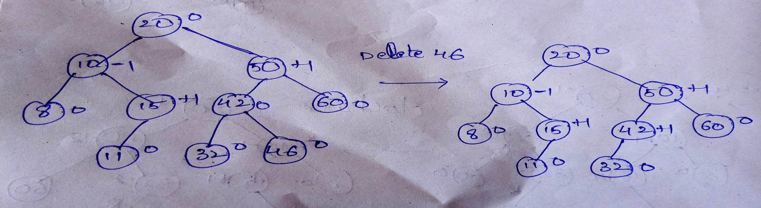

Slide 40
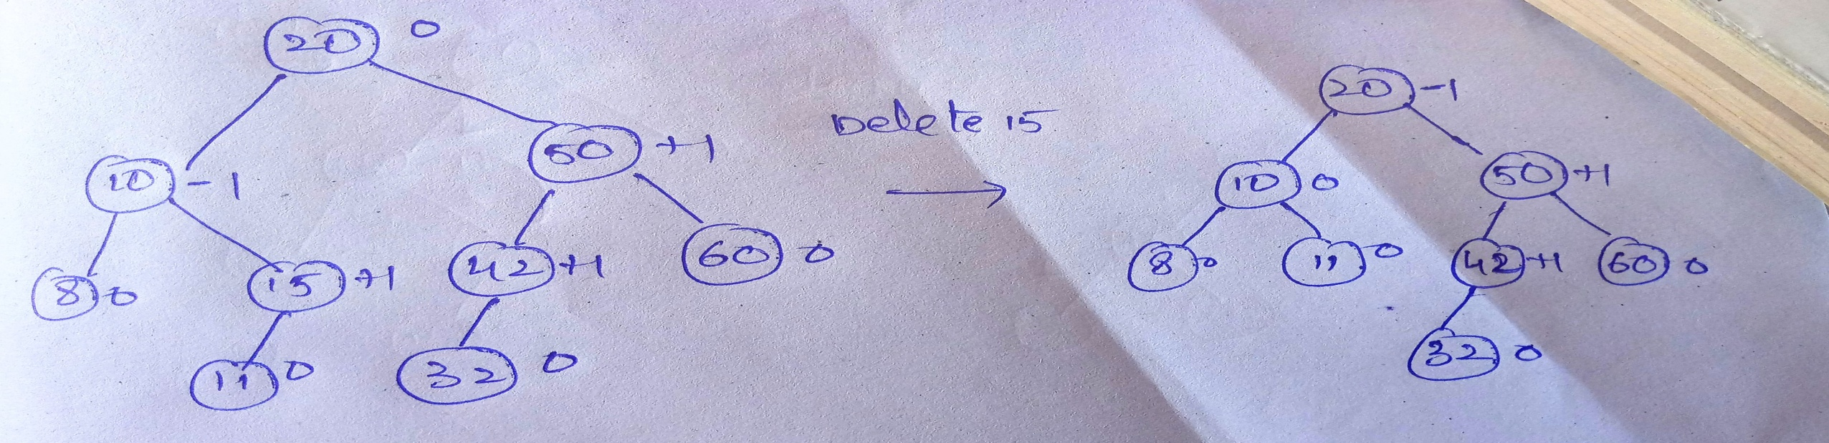
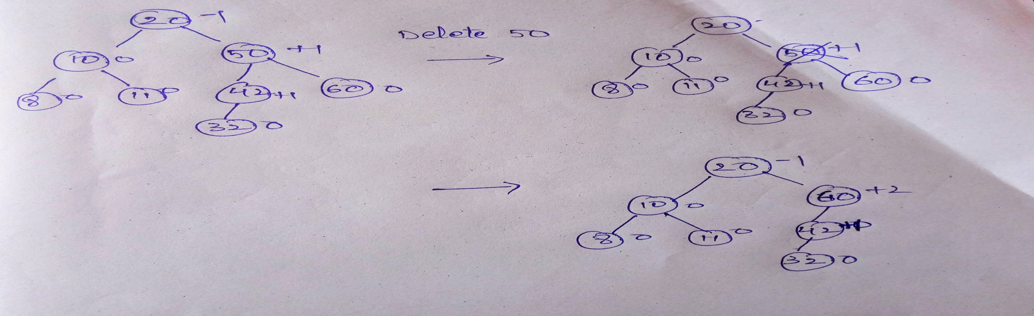

Slide 41
Advantages of AVL trees:
Search is O(log N) since AVL trees are always balanced.
Insertion and deletions are also O(logn), worst case searching is O(1.44 X log n)
The height balancing adds no more than a constant factor to the speed of insertion.
Drawback of AVL trees:
Difficult to program & debug; more space for balance factor.
Asymptotically faster but rebalancing costs time.
Most large searches are done in database systems on disk and use other structures (e.g. B-trees).
May be OK to have O(N) for a single operation if total run time for many consecutive operations is fast (e.g. Splay trees).

Slide 42
RED BLACK TREES

Slide 43
RED BLACK TREE :
The Root Node Should be in Black color .
Insertion Node Should be in red color.
The external nodes should be NULL with a black color.
There is no consecutive two red colors.
Count of black nodes should be same.

Slide 44
Insertion Cases :
Case 1 :
If Root Node is in Red Color change it into Black color.
Example :
16
16
NULL
NULL
NULL
NULL

Slide 45
Case 2 (LL Notation):
When Uncle is Red , Change the color of Parent , Grandparent , Uncle Colors to Opposite colors .
Example :
16
16
16
10
20
10
20
10
20
6
NULL
NULL
6
NULL
NULL
NULL
6
NULL
NULL
NULL
NULL
NULL
NULL
NULL
NULL
NULL
NULL

Slide 46
Case 2 (RR Notation):
16
16
16
10
20
10
20
10
20
26
NULL
NULL
NULL
26
26
NULL
NULL
NULL
NULL
NULL
NULL
NULL
NULL
NULL
NULL
NULL
NULL

Slide 47
CASE 3 ( LR NOTATION):
When Uncle is black and LR or LR Notation occurs , Then Rotate on parent .
Example :
16
16
16
10
10
20
11
20
11
NULL
11
NULL
NULL
NULL
NULL
10
NULL
NULL
Apply Case 4 to get RED BLACK TREE
NULL
NULL
NULL
NULL
NULL

Slide 48
CASE 3 ( RL NOTATION )
16
16
10
20
10
21
NULL
NULL
NULL
21
NULL
NULL
20
NULL
NULL
NULL
NULL
NULL
Apply Case 4 to get RED BLACK TREE

Slide 49
CASE 4 (LL NOTATION) :
When Uncle is Black , LL or RR notation occurs Then Rotate on Grandparent . Change parent , Grandparent color to opposite Colors.
Example :
10
16
10
10
6
16
10
NULL
6
16
6
16
6
NULL
NULL
NULL
NULL
NULL
NULL
NULL
NULL
NULL
NULL
NULL
NULL

Slide 50
Case 4 (RR Notation)
Example :
20
20
16
16
30
16
30
NULL
20
NULL
NULL
NULL
NULL
NULL
NULL
NULL
NULL
NULL
30
NULL
NULL

Slide 51
Deletion Cases :
Case 1 ( 0 child ) :
if the deleted node is red color with 0 childs , then delete it directly.
Example:
10
By Deleting 16
10
NULL
16
NULL
NULL
NULL
NULL

Slide 52
Case 1 (0 child) :
if the deleted node is black node with 0 childs , then delete it and make a double black node .
Example :
10
10
By Deleting 20
6
20
6
N
NULL
NULL
NULL
NULL
NULL
NULL

Slide 53
Case 2 ( 1 child ) :
if the deleted node is red color with one child i.e red or black , Delete it
and replace with its child.
Example :
16
16
By Deleting 10
10
NULL
6
NULL
6
NULL
NULL
NULL
NULL
NULL

Slide 54
Case 2 (1 child) :
if the deleted node is black color with one child
i . That is red child ,Replace content of the parent with child. Delete child.
ii . That is black , make child as double black node .
Example ii : Example i :
10
10
10
10
By Deleting 20
By Deleting 20
20
20
21
21
21
21

Slide 55
Case 3 (2 child) :
if the deleted code is red color with two black childs , replace the content of the node with one of its child .
Example :
10
10
By Deleting 20
20
22
15
22
15

Slide 56
Case 3 ( 2 childs ) :
if the deleted node is black color with two childrens among these atleast one of the child is red , replace the node with red child and change the child color to black.
Example :
Deletion of node with one red child Deletion of node with two red childs
By Deleting 20
15
20
By Deleting 20
15
20
20
22
22
22
15
22
15

Slide 57
Case 3 (2 child ) :
if the deleted node is black color with two black childs , replace the node with the right minimum child or left maximum child then make a double black node on that side.
Example :
20
By Deleting 20
22
15
22
15
N

Slide 58
Deletion of Double black nodes
Case 1:
if the parent node itself a double black node , make it as a single black node.
Example :
1
1
NULL
NULL
NULL
NULL

Slide 59
Case 2 :
When sibling of Double black node is red and their parent is black and children of red node are black (both ). Then rotate through parent and change the colors of parent and sibling .
Example :
30
30
20
31
20
31
20
N
30
21
N
21
21
31
N
Note : Apply other cases to get Red black tree without Double black node

Slide 60
Case 3:
When the sibling of double black node is black and children of siblings are
Black then make the double black node as parent and change the color of sibling to red color .
Example :
2
2
2
1
30
1
30
1
30
21
31
21
31
21
31
Note : Apply other cases to get Red black tree without Double black node

Slide 61
Case 4 :
when sibling of double black node is black and parent is red , childrens of siblings are black then Interchange the color of parent , sibling and remove the double black node .
Example :
2
2
1
30
1
30
21
31
21
31

Slide 62
Case 5 :
When sibling , parent of the double black node is black color , left child is in red color then rotate through sibling and interchange the color of sibiling and left child .
Example :
2
2
2
1
21
1
21
1
30
30
30
21
31
31
31
Note : Apply other cases to get Red black tree without Double black node

Slide 63
Case 6 :
When parent of double black node , left child of sibling is in any color and right child of sibling is in red color .
Then ,
Rotate through parent
Make color of double black node Sibling as color of Double black node parent color.
Make double black node parent color always black.
Convert right child into Black color.
Convert double black node into single black node.

Slide 64
Properties
It has less rotations compared to AVL trees.
It take low memory space than AVL trees .
It provide Faster insertion and deletion Operations.
It has Searching Time complexity O(2*Log N)

Slide 65
INSERTION
Elements are 45,39,56,12,34,78,32,10,89,54,67,81
step 1:inserting 45
45
45
case 1
N
N
N
N

Slide 66
INSERTION
step 2:inserting 39 step 3:inserting 56
45
45
39
N
39
56
N
N
N
N
N
N

Slide 67
INSERTION
step 4:inserting 12
45
45
case 2,case 1
39
56
39
56
12
N
N
N
12
N
N
N
N
N
N
N

Slide 68
INSERTION
step 5:inserting 34
45
45
39
56
39
56
case 3
34
N
case 4
12
N
N
N
N
N
12
N
N
34
N
N
N
N

Slide 69
INSERTION
step 6:inserting 78
45
45
34
56
34
56
case 4
12
12
39
N
78
39
N
N
N
N
N
N
N
N
N
N
N
N

Slide 70
INSERTION
step 7:inserting 32
45
45
34
56
34
56
case 3
12
78
12
39
N
78
39
N
N
32
N
N
N
N
N
32
N
N
N
N
N
N
N
N

Slide 71
INSERTION
step 8:inserting 10
45
34
56
12
39
78
N
10
32
N
N
N
N
N
N
N
N

Slide 72
INSERTION
step 9:inserting 89
45
45
78
34
34
56
case 4
12
56
89
78
39
12
39
N
10
32
N
N
10
32
N
89
N
N
N
N
N
N
N
N
N
N
N
N
N
N
N
N

Slide 73
INSERTION
45
step 10:inserting 54
45
34
78
34
78
case 2
12
39
56
89
12
39
56
89
10
32
54
N
N
N
N
N
N
N
10
32
N
N
54
N
N
N
N
N
N
N
N
N
N
N
N
N

Slide 74
INSERTION
step 11:inserting 67 step 12:inserting 81
45
45
34
78
34
78
case 2
12
39
56
89
12
39
56
89
10
32
54
N
N
N
N
67
81
N
10
32
N
N
54
67
N
N
N
N
N
N
N
N
N
N
N
N
N
N
N
N
N
N

Slide 75
DELETION
Deleting elements are 54,56,12,39,32,45,34,78,67,10
1) deleting 54,here 54 is in red color with no childs so delete directly
45
45
34
78
34
78
deleting 54
12
39
56
89
12
39
89
56
10
32
67
81
N
81
N
N
N
N
10
32
N
N
54
67
N
N
N
N
N
N
N
N
N
N
N
N
N
N
N
N
N
N

Slide 76
DELETION
2) delete 56,here 56 has one red children
45
45
34
78
34
78
deleting 56
12
39
67
89
12
39
89
56
10
32
N
81
N
81
N
N
N
N
10
32
N
N
N
67
N
N
N
N
N
N
N
N
N
N
N
N
N
N

Slide 77
DELETION
3) delete 12,here 12 has two red childrens so replace with min value from right
45
45
34
78
34
78
deleting 12
32
39
67
89
12
39
89
67
10
N
N
81
N
81
N
N
N
N
10
32
N
N
N
N
N
N
N
N
N
N
N
N
N
N

Slide 78
DELETION
4) delete 39,here 39 is leaf with black color
45
45
34
78
34
78
N
deleting 39
32
N
67
89
32
39
89
67
10
N
N
81
N
81
N
N
10
N
N
N
N
N
N
N
N
N
N
N
N
N

Slide 79
45
32
78
case 6
10
34
67
89
N
N
N
N
N
N
81
N
N
N

Slide 80
DELETION
5) delete 32(replace with max value from left sub tree)
45
45
10
78
32
78
deleting 32
N
34
N
67
89
10
34
89
67
N
N
N
N
N
81
N
81
N
N
N
N
N
N
N
N
N
N

Slide 81
45
10
78
case 4
N
34
67
89
N
N
N
N
81
N
N
N

Slide 82
DELETION
6) delete 45(take max value from left sub tree)
34
45
10
78
10
78
deleting 45
N
N
67
89
N
34
89
67
N
N
N
81
N
81
N
N
N
N
N
N
N
N

Slide 83
DELETION
7) delete 34(take max value from left sub tree)
10
34
N
78
10
78
deleting 34
67
89
N
N
89
67
N
N
N
81
N
81
N
N
N
N
N
N

Slide 84
DELETION
78
78
10
89
89
case 2
10
case 4
67
81
N
67
81
N
N
N
N
N
N
N
N
N
N
N

Slide 85
DELETION
8) delete 78 (take max value from left sub tree)
78
67
10
89
89
10
deleting 78
N
67
81
N
N
81
N
N
N
N
N
N
N
N

Slide 86
DELETION
9) delete 67 (take max value from left sub tree)
67
10
10
89
89
N
deleting 67
N
N
81
N
81
N
N
N
N
N

Slide 87
DELETION
10
81
case 5
N
81
10
89
case 6
N
N
N
N
89
N
N
N
N
N

Slide 88
DELETION
10) delete 10
81
81
81
10
case 3
89
89
deleting 10
89
N
N
N
N
N
N
N
N
N
N
case 1
81
N
89
N
N

Slide 89
DRAWBACKS OF RED BLACK TREE
In Red Black Tree the searching complexity is O(log n).
When we are searching a node for multiple times or different people searching for a same node for each searching the time complexity is O(log n).
To overcome this draw back we are moving to Splay tree.
You can check red black tree introduction, Creation: https://www.youtube.com/watch?v=5KY_byy8kKU
You can check red black tree analyzation:
https://www.youtube.com/watch?v=HzxjohFympI
You can check red black tree Deletion part-1:
https://youtu.be/vLQRWhfd1V4
You can check red black tree Deletion part-2:
https://youtu.be/YVNWewo3QKc

Slide 90
TRIE:
A trie is an ordered tree data structure, which was introduced in the 1960s by Edward Fredkin.
Trie stores keys that are usually strings.
A trie node contains two fields
-map character and
-a boolean value(i.e end of word)
Maximum height of a trie tree is 25(because there are 26 alphabets are there to form strings).
Maximum or worst case time complexity required to search for a string is O(26).

Slide 91
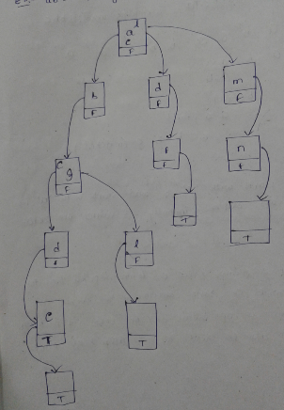
Creation of trie
Ex: abcd, abgl , cdf , abcde , lmn

Slide 92
Deletion in trie
Delete “abcd” in the above example:
as “abcd” and “abcde” both are having same ancestors if we delete “abcd” we loose “abcde” so place false in the boolean value of “e”
Delete “abgl” in the above example:
as “abcd” and “abgl” both are having same ancestors as “ab”
So delete ‘g’ ,before deleting ‘g’ you must have to delete its map character and its boolean value i.e delete ‘l’ first and then delete ‘g’.
See the following tree for better understanding........

Slide 93
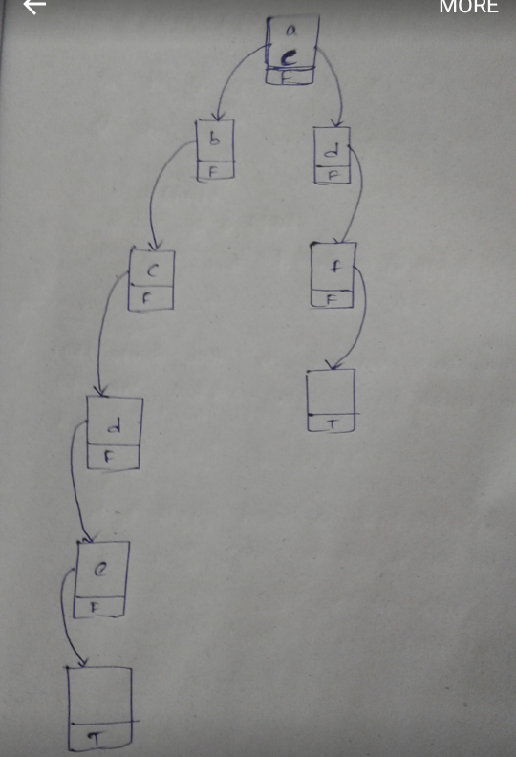
Deletion example
Delete abcd,abgl and lmn

Slide 94
Advantages
Faster Search
Less space
Easily find longest prefix matching
Applications:
To store Dictionary ( ex: mobile telephone)
Matching algorithms
Spell checking software's

Slide 95
Summarization of trie
If two strings having a common prefix then they will have a same ancestrors.
While performing inserion of some keys you can place a key in existing trie node if they both have same ancestors. i.e while creating abcde,abgl you can place letter ‘g’ in ‘c’ node.
While performing deletion first delete the corresponding map character or boolean value.

Slide 96
Augmented Data Structures: 1)Ordered Statistics 2)Interval Trees.
For ordered statistics: https://youtu.be/P-pDEJB6ITs
For Interval Trees: https://youtu.be/D1b7q2TMrWY
For Skip List : Refer the class notes

Slide 97
SPLAY TREE
Like AVL and Red Black Tree, Splay tree is also a self balancing Binary Search Tree.
The main idea of Splay tree is to bring the recently accessed element to root node of the tree.
This makes the recently searched element to be accessible in O(1) time if accessed again.

Slide 98
In Splay Tree we can perform insertion, deletion ,searching .
After performing operations in a Splay Tree we follow some notations depending upon the created tree or previous nodes.They are:
Zig notation(rotating in clock wise)
Zag notation (rotating in anti-clock wise)

Slide 99
Zig-Zig notation( rotating clock wise and again clock wise).
Zag-Zag notation(rotating anti-clock wise and again anti-clock wise).
Zig-Zag notation (rotating first clock wise and then anti-clock wise).
Zag-Zig notation(rotating first anti-clock wise and then clock wise).

Slide 100
TIME COMPLEXITY
ALGORITHM | AVERAGE | Searching recent node
SEARCHING | O(log n) | O(1)
INSERTION | O(log n) | O(1)
DELETION | O(log n) | O(1)

Slide 101
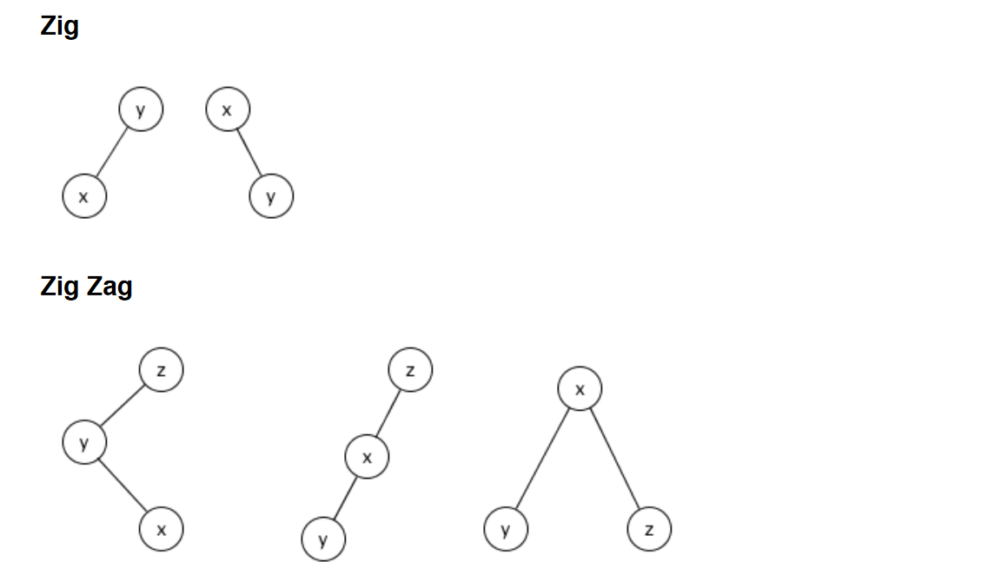
NOTATIONS
In the tree the recently added element is x. so x must be in top(root node)in splay tree. For that rotate the node in clockwise with respect to y.
THIS IS ZAG-ZIG NOTATION:
In the tree the recently added element is x. so x must be in top(root node)in splay tree. For that rotate the node in anti-clockwise with respect to y. And then rotate clockwise with respect to y.

Slide 102
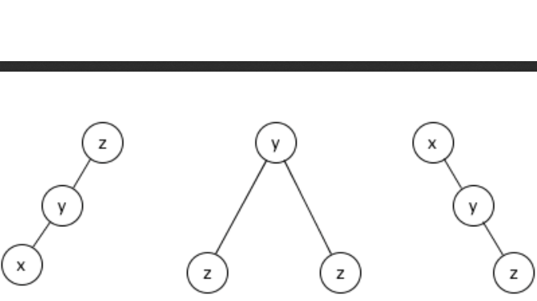
In the tree the recently added element is x. so x must be in top(root node)in splay tree. For that rotate the node in clockwise with respect to y. And then again rotate clockwise with respect to y.
Zig-zig:

Slide 103
DRAWBACK IN SPLAY TREE
The height of the Splay Tree can be linear.
Then it takes more time to access an element(i.e.,it takes worst case time).
When the is in ascending or descending order the access time is O(n).
To overcome this drawback we are moving to multiway search tree(M-way search tree).

Slide 104
MULTIWAY SEARCH TREE
A Multi way search tree is one with nodes that have two or more children.
A binary search tree is a multi way search tree.
It is used mostly used to access the data from secondary storage devices. Eg: hard disk.
Because they allow large amount of data to be stored in a node.
In M-way search tree each node has maximum of m children and (m-1) keys.

Slide 105
The keys in each node are in ascending order.
The keys in the first i children are smaller than the i’th key.
The keys in the last m-i children are larger than the i’th key.
We can perform insertion, deletion, searching.

Slide 106
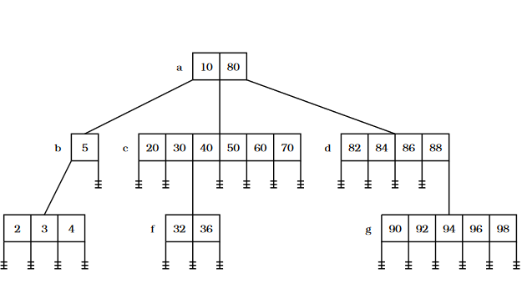
Example :

Slide 107
DRAW BACK IN M-WAY SEARCH TREE
When the tree is skewed(either left skewed or right skewed) it takes more time to access the node.
Eg: creating a m-way tree for the given nodes 1,2,3,4,5,6,7,8,9.
1
2
3
4
5
6
7
8
9
To overcome this drawback we are moving to B-tree.

Slide 108
B-Trees

Slide 109
Motivation for B-Trees
Index structures for large datasets cannot be stored in main memory
Storing it on disk requires different approach to efficiency
Assuming that a disk spins at 3600 RPM, one revolution occurs in 1/60 of a second, or 16.7ms
Crudely speaking, one disk access takes about the same time as 200,000 instructions

Slide 110
Motivation (cont.)
Assume that we use an AVL tree to store about 20 million records
We end up with a very deep binary tree with lots of different disk accesses; log₂ 20,000,000 is about 24, so this takes about 0.2 seconds
We know we can’t improve on the log n lower bound on search for a binary tree
But, the solution is to use more branches and thus reduce the height of the tree!
As branching increases, depth decreases

Slide 111
Definition of a B-tree
A B-tree of order m is an m-way tree (i.e., a tree where each node may have up to m children) in which:
1. the number of keys in each non-leaf node is one less than the number of its children and these keys partition the keys in the children in the fashion of a search tree
2. all leaves are on the same level
3. all non-leaf nodes except the root have at least ⎡m / 2⎤ children
4. the root is either a leaf node, or it has from two to m children
5. a leaf node contains no more than m – 1 keys
The number m should always be odd or even

Slide 112
An example B-Tree
26
A B-tree of order 5 containing 26 items
6
12
42
51
62
1
2
4
7
8
13
15
18
25
27
29
45
46
48
53
55
60
64
70
90
Note that all the leaves are at the same level

Slide 113
Constructing a B-tree
Suppose we start with an empty B-tree and keys arrive in the following order:1 12 8 2 25 5 14 28 17 7 52 16 48 68 3 26 29 53 55 45
We want to construct a B-tree of order 5
The first four items go into the root:
To put the fifth item in the root would violate condition 5
Therefore, when 25 arrives, pick the middle key to make a new root
1
2
8
12

Slide 114
Constructing a B-tree (contd.)
8
1
2
12
25
6, 14, 28 get added to the leaf nodes:
8
1
2
6
12
14
25
28

Slide 115
Constructing a B-tree (contd.)
Adding 17 to the right leaf node would over-fill it, so we take the middle key, promote it (to the root) and split the leaf
8
17
1
2
6
12
14
25
28
7, 52, 16, 48 get added to the leaf nodes
8
17
1
2
6
7
12
14
16
25
28
48
52

Slide 116
Constructing a B-tree (contd.)
Adding 68 causes us to split the right most leaf, promoting 48 to the root, and adding 3 causes us to split the left most leaf, promoting 3 to the root; 26, 29, 53, 55 then go into the leaves
3
8
17
48
1
2
6
7
12
14
16
25
26
28
29
52
53
55
68
Adding 45 causes a split of
25
26
28
29
and promoting 28 to the root then causes the root to split

Slide 117
Constructing a B-tree (contd.)
17
3
8
28
48
1
2
6
7
12
14
16
25
26
29
45
52
53
55
68

Slide 118
Inserting into a B-Tree
Attempt to insert the new key into a leaf
If this would result in that leaf becoming too big, split the leaf into two, promoting the middle key to the leaf’s parent
If this would result in the parent becoming too big, split the parent into two, promoting the middle key
This strategy might have to be repeated all the way to the top
If necessary, the root is split in two and the middle key is promoted to a new root, making the tree one level higher

Slide 119
Exercise in Inserting a B-Tree
Insert the following keys to a 5-way B-tree:
3, 7, 9, 23, 45, 1, 5, 14, 25, 24, 13, 11, 8, 19, 4, 31, 35, 56

Slide 120
Removal from a B-tree
During insertion, the key always goes into a leaf. For deletion we wish to remove from a leaf. There are three possible ways we can do this:
1 - If the key is already in a leaf node, and removing it doesn’t cause that leaf node to have too few keys, then simply remove the key to be deleted.
2 - If the key is not in a leaf then it is guaranteed (by the nature of a B-tree) that its predecessor or successor will be in a leaf -- in this case we can delete the key and promote the predecessor or successor key to the non-leaf deleted key’s position.

Slide 121
Removal from a B-tree (2)
If (1) or (2) lead to a leaf node containing less than the minimum number of keys then we have to look at the siblings immediately adjacent to the leaf in question:
3: if one of them has more than the min. number of keys then we can promote one of its keys to the parent and take the parent key into our lacking leaf
4: if neither of them has more than the min. number of keys then the lacking leaf and one of its neighbours can be combined with their shared parent (the opposite of promoting a key) and the new leaf will have the correct number of keys; if this step leave the parent with too few keys then we repeat the process up to the root itself, if required

Slide 122
Type #1: Simple leaf deletion
Assuming a 5-way
B-Tree, as before...
12
29
52
2
7
9
15
22
31
43
56
69
72
Delete 2: Since there are enough
keys in the node, just delete it
Note when printed: this slide is animated

Slide 123
Type #2: Simple non-leaf deletion
12
29
52
56
Delete 52
7
9
15
22
31
43
56
69
72
Borrow the predecessor
or (in this case) successor
Note when printed: this slide is animated

Slide 124
Type #4: Too few keys in node and its siblings
12
29
56
Join back together
7
9
15
22
31
43
69
72
Too few keys!
Delete 72
Note when printed: this slide is animated

Slide 125
Type #4: Too few keys in node and its siblings
12
29
7
9
15
22
31
43
56
69
Note when printed: this slide is animated

Slide 126
Type #3: Enough siblings
12
29
Demote root key and
promote leaf key
7
9
15
22
31
43
56
69
Delete 22
Note when printed: this slide is animated

Slide 127
Type #3: Enough siblings
12
31
7
9
15
29
43
56
69
Note when printed: this slide is animated

Slide 128
Analysis of B-Trees
The maximum number of items in a B-tree of order m and height h:
root m – 1
level 1 m(m – 1)
level 2 m²(m – 1)
. . .
level h m^{h}(m – 1)
So, the total number of items is (1 + m + m² + m³ + … + m^{h})(m – 1) = [(m^{h+1} – 1)/ (m – 1)] (m – 1) = m^{h+1} – 1
When m = 5 and h = 2 this gives 5³ – 1 = 124

Slide 129
Reasons for using B-Trees
When searching tables held on disc, the cost of each disc transfer is high but doesn't depend much on the amount of data transferred, especially if consecutive items are transferred
If we use a B-tree of order 101, say, we can transfer each node in one disc read operation
A B-tree of order 101 and height 3 can hold 101⁴ – 1 items (approximately 100 million) and any item can be accessed with 3 disc reads (assuming we hold the root in memory)
If we take m = 3, we get a 2-3 tree, in which non-leaf nodes have two or three children (i.e., one or two keys)
B-Trees are always balanced (since the leaves are all at the same level), so 2-3 trees make a good type of balanced tree

Slide 130
Comparing Trees
Binary trees
Can become unbalanced and lose their good time complexity (big O)
AVL trees are strict binary trees that overcome the balance problem
Heaps remain balanced but only prioritise (not order) the keys
Multi-way trees
B-Trees can be m-way, they can have any (odd) number of children
One B-Tree, the 2-3 (or 3-way) B-Tree, approximates a permanently balanced binary tree, exchanging the AVL tree’s balancing operations for insertion and (more complex) deletion operations

Slide 131
Applications of B-Trees
1) These are used to index the data and provide fast access.
2) We will be able to fetch a large amount of data in one disk access.
3) Disk is block oriented device. i.e., data organized and retrieved in terms of blocks. So, while using a B tree, a large value of m is used so that one single node can occupy the entire block.
4) A large value minimizes the height of the tree. So, search operation becomes really fast.

Slide 132
B+ Trees

Slide 133
Introduction
Defintion:
A B+ tree is a tree in which all the data is placed(stored) only in the leaf nodes and internal nodes are contained with their indexs of the corresponding data.
In B+ trees internal nodes are used as index for searching data, so the nodes(internal nodes) are called INDEX NODES.
In B+ trees leaf nodes contains data items and they are called DATA NODES.
Index nodes forms a index set and Data nodes forms a Sequence set.

Slide 134
Introduction
Why Moving to B+ trees ?:
We are moving to B+ trees as already we have B trees is due to mainly for sequential access of data.
As we use these M-way search trees to work on the disk memory(not on primary memory).Which will take a less time than using a binary tree for this.
So, In B trees we can access a group of data at a time which will reduce the time of accessing than Binary trees(as in binary trees we access only one item). But while we perform an inorder traversal in B-trees at the internal nodes it is again taking a single data at once. So for this we are moving to B+ trees.
As in B+ trees all the leaf nodes are connected to each adjacent node as they form a linked list. We can directly perform sequential access of the data without visiting every internal nodes. So it will improve the efficiency of accessing.

Slide 135
Introduction
There are two main differences between B and B+ trees.
1)In B tree, all nodes contain keys,their corresponding data items and children(child pointers). But in B+ tree the structers of Leaf nodes and internal nodes are different.
The internal nodes stores only keys and child pointers while the leaf nodes store the keys and corresponding data items. [in general we didn’t mention both the keys and corresponding data.. we only mention data only]. So the data items only present in the leaf nodes.
[The keys in the leaf nodes may be present in the internal nodes] check the followoing figure.
2)In B+ trees each leaf node has a pointer to the next leaf node, where is there is nothing like that in B trees.

Slide 136
Ffigure:
B-Tree
n=data item
D_{n}=key of data
B+ Tree
index
30
30
D₃₀
pointer
12 20
D₁₂ D₂₀
40 50
D₄₀ D₅₀
12 20
D₁₂ D₂₀
30 40 50
D₃₀ D₄₀ D₅₀
General representation
30
30
Data items
12 20
40 50
12 20
30 40 50

Slide 137
Searching:
- Searching is somewhat different from B trees to B+ trees . As in B trees when we find the corresponding data, we stop the process whereas in B+ trees we need to search till we find a data in leaf node (wheather if it found in internal nodes or not).
- B+ trees supports efficient range queries i.e.,we can access all the data in a given range.For this we need to search starting key of the range and then sequentially traverse the leaf nodes till we get tge end key of the range.

Slide 138
Insertion
In the process of insertion there are two cases depending on wheather the leaf nodes has maximum keys or not.
If the leaf nodes has less than the maximum keys, then key and data are simply inserted in the leaf node in ordered manner and the index set is not changed.[Case-1]
If the leaf nodes has the maximum keys ,then we will have to split the leaf node .The splitting of leaf node is slightly different from splitting of a node in B-tree.
A new leaf node is allocated and inserted in the sequential set(linked list of leaf nodes) after the old node. All the keys smaller than the median key remain in the old leaf node and all the keys greater than or equal to the median key are moved to the new node, the corresponding data items are also moved.[the meadian key becomes the 1st node of the new node ], so the key is copied[not moved] to the parent node which is an internal node.
So this median key is present in both internal node and leaf node.

Slide 139
Insertion
In some cases the index nodes also got maximum keys and there we need to split those nodes also.
Splitting of a Leaf node:
Keys < meadian remain in the old node.[with data]
Keys >= median move to the new leaf node.[with data]
Medain key is copied to parent node.
If after splitting of leaf node , the parent becomes full then again a split has to be done at internal node. This splitting is similar to the splitting a node in B-tree.

Slide 140
Insertion
Splitting an inrernal node:
Keys < meadian remain in the old leaf node.
Keys > meadian move to the new node.[with data]
Median key is moved to parent node.
This process is continued till we get a non full parent node.
Now let see an example of insertion of nodes.

Slide 141
Construct a B+ tree in order of 5 with the elements 35,63,24,10,12,39,89,72,11,8,4,18,78,80
1) insert 35: as it is the 1st node we can directly insert the data in node.
35
Here we can represent the node
With only data or we can insert both
Key and data
2) insert 63: we have the order of 5 ,we can insert 4 data values in a single node
so we can insert the data directly into the node. As 65 > 35 it is inserted right side of the 35.
35 65

Slide 142
3) insert 24: now also we can directly insert the data in the node as it doesn’t reach the
Max order.
24 35 63
4)insert 10: now directly insert
10 24 35 63
5)insert 12: here after inserting the leaf node is exceeds max keys so we need to do
Splitting of leaf node.
24
10 12 24 35 63
Splitting
10 12
24 35 63

Slide 143
6) insert 39: now we need to find the element in which leaf node to insert[by using their index
Nodes. And 39 is directly inserted.
24
10 12
24 35 39 63
7)insert 89: now here after inserting the leaf node exceeds the max keys. So we need to
Split the leaf node.
splitting
24 39
24
10 12
24 35
39 63 89
10 12
24 35 39 63 89

Slide 144
8) insert 72: here we can insert directly as no leaf node is with max keys.
24 39
10 12
24 35
39 63 72 89
9) insert 11: here now it also can directly inserted.
24 39
10 11 12
24 35
39 63 72 89

Slide 145
10) insert 8: it is also directly inserted.
24 39
8 10 11 12
39 63 72 89
24 35
11) insert 4: Here after inserting 4 it excceds the max keys in the leaf node so we need tosplit
24 39
10 24 39
splttting
4 8
24 35
39 63 89
10 11 12
4 8 10 11 12
24 35
39 63 72 89

Slide 146
12) insert 18: here the data is directly inserted.
10 24 39
4 8
10 11 12 18
24 35
39 63 89
13) insert 78: now it is also can be inserted directly.
10 24 39
39 63 78 89
4 8
10 11 12 18
24 35

Slide 147
14)insert 80: after inserting 80 in the leaf node it exceeds the maximum keys so it needs to be
Split.
10 24 39
4 8
10 11 12 18
24 35
39 63 78 80 89
spl
10 24 39 78
This is B+ tree after inserting all the elements.
24 35
39 63
78 80 89
4 8
10 11 12 18

Slide 148
Deletion:
Before deleting an element from a B+ tree.. 1st we need to do search operation.
If the key [and data] is present in the leaf node,then only we go for deletion operation.
There are 2 different cases to delete a data the key and data item by depending on wheather the leaf node has minimum keys or more than that.
Leaf node having more than minimum elements
Leaf node having minimum number of elements.
This case again have 2 different cases
Any one of the sibiling has more than minimum elements than a key.
Both sibiings has minimum number of elements.

Slide 149
Deletion
Case1: If the leaf node has more than minimum elements then we can simply delete the key and its data item,and move other elements of the leaf node if required and delete if it is present in index node also
In this case the index set is also changed.
[there is another procedure by without deleting the key in the index].
Ex:
35
30
Delete 30
10 12
30 35 40 45
10 12
35 40 45

Slide 150
Deletion
Case2: If the key is present in a leaf node which has minimum number of elements .
There we have two subcases:-
If any one of the sibiling has more than minimum nodes then a key is borrowed from it and the separator key in the parent node is updated accordingly.
Ex:
30
Delete 12
35
10 12
30 35 40 45
35 40 45
10 30

Slide 151
Deletion
If both sibilings have minimum nodes then we need to merge the underflow leaf node with its any one of the sibling.
This is done by moving the keys[with data] of underflow leaf node to the sibiling node and deleting the underflow leaf node.
The separator key of the underflow node and its sibilig node is deleted from the parent node.
The merging of the leaf nodes may result in an underflow parent node which is an internal node. For internal nodes borrowing and merging is performed in same manner as in B trees.

Slide 152
Delete the elements 12,38,15,48,50,60 from the following B+ tree.
30
12 20 25
40 50
25 27 28
50 60 90
5 10
12 15 19
30 35 38
20 24
40 42 45 48

Slide 153
1)Delete: 12 Now 12 is present in the leaf node which has more than minimum keys.So we
Can directly delete the element from the leaf node and also from the parent node and update
The separator.
30
Here 12 is delete
And updated
Parent node
15 20 25
40 50
25 27 28
50 60 90
5 10
15 19
30 35 38
20 24
40 42 45 48

Slide 154
2)Delete: 38 Now 38 is present in the leaf node which has more than minimum keys.So we
Can directly delete the element from the leaf node and also from the parent node and update
The separator.
30
Here 38 is delete
And no need to
Update parent noe
15 20 25
40 50
25 27 28
50 60 90
5 10
15 19
30 35
20 24
40 42 45 48

Slide 155
3)Delete 15: Now 15 is present in the leaf node which has minimum number of keys.So we
Can’t directly delete the element from the leaf node. As the sibiling nodes also has the minimum
Number of keys we need to merge the node with sibiling node.
30
While deleting the element delete the
Separator also and update the parent node
Here 15 is delete
By merging
And
Update parent noe
20 25
40 50
20 24
25 27 28
50 60 90
5 10 19
30 35
40 42 45 48

Slide 156
4)Delete 48: Now 48 is present in the leaf node which has more than minimum number of keys.So we can simply delete the element with out any need to change the parent node.
30
Here 48 is deleted
And no need to
Updare the parent
node
20 25
40 50
20 24
25 27 28
50 60 90
5 10 19
30 35
40 42 45

Slide 157
5)Delete 50: Now 50 is present in the leaf node which has more than minimum number of keys.So we can simply delete the element with out any need to change the parent node.
30
Here 50 is deleted
And need to
Updare the parent
node
20 25
40 60
20 24
25 27 28
60 90
5 10 19
30 35
40 42 45

Slide 158
6)Delete 60: Now 60 is present in the leaf node which has minimum number of keys.So we can’t simply delete the element. So here the left sibiling has more than minimum no of keys so we can barrow from it and update the parent node.
30
Here 60 is deleted from the leaf node and parent node.now we barrow 45 from left sibiling and updated the parent node also.
Here 50 is deleted
And no need to
Updare the parent
node
20 25
40 45
20 24
25 27 28
45 90
5 10 19
30 35
40 42
This is the B+ tree after deleting some elements.

Slide 159
Queries???
(anilkumar10491@rguktsklm.ac.in)

